Slide 1
Data Structure
Introduction

Slide 2
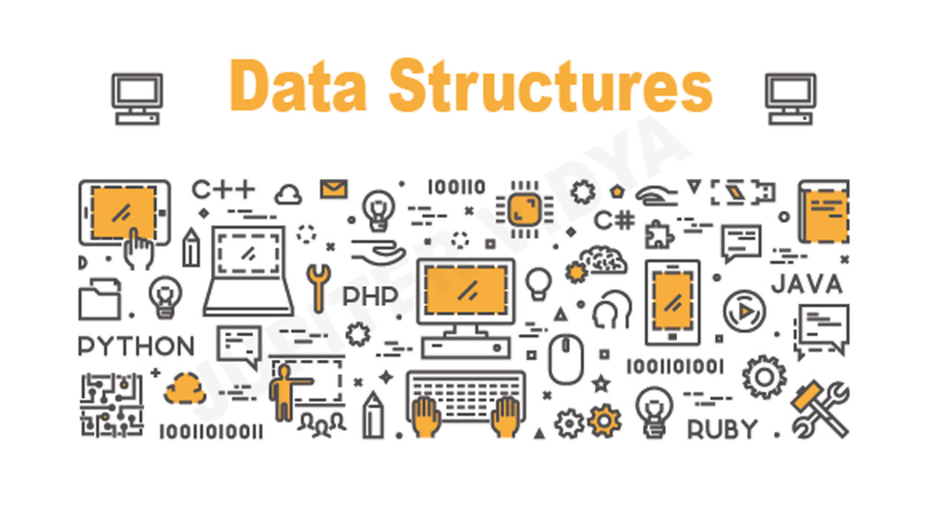
Agendas
What is Data Structure?
Basic “Primitive” Data Types
Abstract Data Types “ADTs”
Data Structure & Data Types
Data Organizing Principles
Five Steps per Data Structure
Data Structure Examples

Slide 3
What is Data Structure?
In computer science, a data structure is a particular way of organizing data in a computer memory, so that it can be used efficiently.
Why it’s important?
It affect the performance of applications.
Good structure can make application maintenance easier.

Slide 4
What is Data Structure?
Real Life Example:
A simple example for data structure in real life would be the library.
Library has Books, Articles, Journals and other documents, those could represent Data. And there are several operations can be done in the library, like adding new books, updating journals or delete documents.
So, with this data structure it will be easy to search for books or lending them. The same goes to adding new books.

Slide 5
What is Data Structure?
Technical Examples:
Google use data structures to store data and to process it “Graphs & Vectors”.
Researchers use data structure to facilitate their work on data “Lists & Maps”.
Applications like the ones in Paltel and Banks use some kind of data structures “Queue”.

Slide 6
Agendas
What is Data Structure?
Basic “Primitive” Data Types
Abstract Data Types “ADTs”
Data Structure & Data Types
Data Organizing Principles
Five Steps per Data Structure
Data Structure Examples

Slide 7
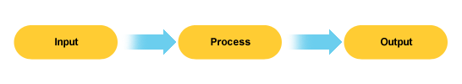
Basic “Primitive” Data Types
All software applications need input data, then they will process this data to generate output. So, what is data? It’s the set of characters, numbers, bits and other primitive types of data.

Slide 8
Basic Data Types
As we will conduct Java as our course programming language, here are the primitive data types in Java:
byte | 8-bit | short | 16-bit
int | 32-bit | long | 64-bit
float | 32-bit | double | 64-bit
boolean | Size not defined. | char | 16-bit

Slide 9
Basic Data Types - Domains & Operations
Every data type has it’s own (i) Domain and (ii) Operations.
Data Type | Domain | Operations
boolean | 0,1 | and, or, =, etc.
char | 32-bit | =, <>, <, etc.
integer | Size not defined. | +, _, =, ==, <>, <, etc.

Slide 10
Agendas
What is Data Structure?
Basic “Primitive” Data Types
Abstract Data Types “ADTs”
Data Structure & Data Types
Data Organizing Principles
Five Steps per Data Structure
Data Structure Examples

Slide 11
Abstract Data Types
What is Abstract?
Abstraction is a term referring to hiding details, and showing only essential data or information.
ADT?
It’s a type of Data Structure in which details and operations implementation are hidden under main data structure.
Elements
Domain
Structure
Specification
Representation
Implementation
Operations

Slide 12
Abstract Data Types
ADT Examples
String
This is one of the most used and known ADTs. In Java, String is a class that has several methods and has domain of data which is usually characters and numbers.
Student Class
Any created Java Bean considered as ADT, it will represent an object that has domain of datatypes and methods.

Slide 13
Abstract Data Types - String Example
Specification
Elements: type char.
Structure: elements (characters) are linearly arranged.
Domain: type String, finite domain, there are 0 to 80 chars in a string, therefore 1+128+1282+…..+12880 possible stings in the domain.
Operations: substring(); length();

Slide 14
Agendas
What is Data Structure?
Basic “Primitive” Data Types
Abstract Data Types “ADTs”
Data Structure & Data Types
Data Organizing Principles
Five Steps per Data Structure
Data Structure Examples

Slide 15
Data Structure & Data Types
Built-in data types Those data types are defined in the programming language, like int, char, boolean.
User-defined data types
Those data types are defined by the implementer, we use data types and structure to provide new data type like creating new class for Employee.
How data types are related to data structure?
A simple question would be that data types form the domain of data structures.

Slide 16
Agendas
What is Data Structure?
Basic “Primitive” Data Types
Abstract Data Types “ADTs”
Data Structure & Data Types
Data Organizing Principles
Five Steps per Data Structure
Data Structure Examples

Slide 17
Data Organizing Principles
Ordering:
Put keys into some order so that we know something about where each key is are relative to the other keys.
Phone books are easier to search because they are alphabetized.
Linking:
Add pointers to each record so that we can find related records quickly.
E.g. The index in the back of book provides links from words to the pages on which they appear.

Slide 18
Data Organizing Principles
Partitioning:
Divide the records into 2 or more groups, each group sharing a particular property.
E.g. Multi-volume encyclopedias (Aa-Be, W-Z)
E.g. Folders on your hard drive

Slide 19
Agendas
What is Data Structure?
Basic “Primitive” Data Types
Abstract Data Types “ADTs”
Data Structure & Data Types
Data Organizing Principles
Five Steps per Data Structure
Data Structure Examples

Slide 20
Data Organizing Principles
Understand DT Abstractly
Write a Specification
Write Applications
Select, Design, Implement
Analyze the Implementation

Slide 21
Data Organizing Principles - #1 Understanding
Start with the data structure at the level of concepts and pictures. e.g. visualize a stack and the operations of pushing / popping.
Understand simple applications.
Simulate by hand e.g., use a stack to reverse the order of letters in a word.

Slide 22
Data Organizing Principles - #2 Specification
Write a specification for a Java class that could implement the data structure.
Headings for constructor, public methods, public features
Includes precondition / postcondition for each method
Independent of implementation!

Slide 23
Data Organizing Principles - #3 Application
Based on the specification, write small applications to illustrate the use of the data structure.
“Test the specification” prior to implementation.
Code not yet compiled / run.

Slide 24
Data Organizing Principles - #4 Implementation
Select appropriate data types.
Implement as private class vars.
Write rules relating instance variables to abstract specification.

Slide 25
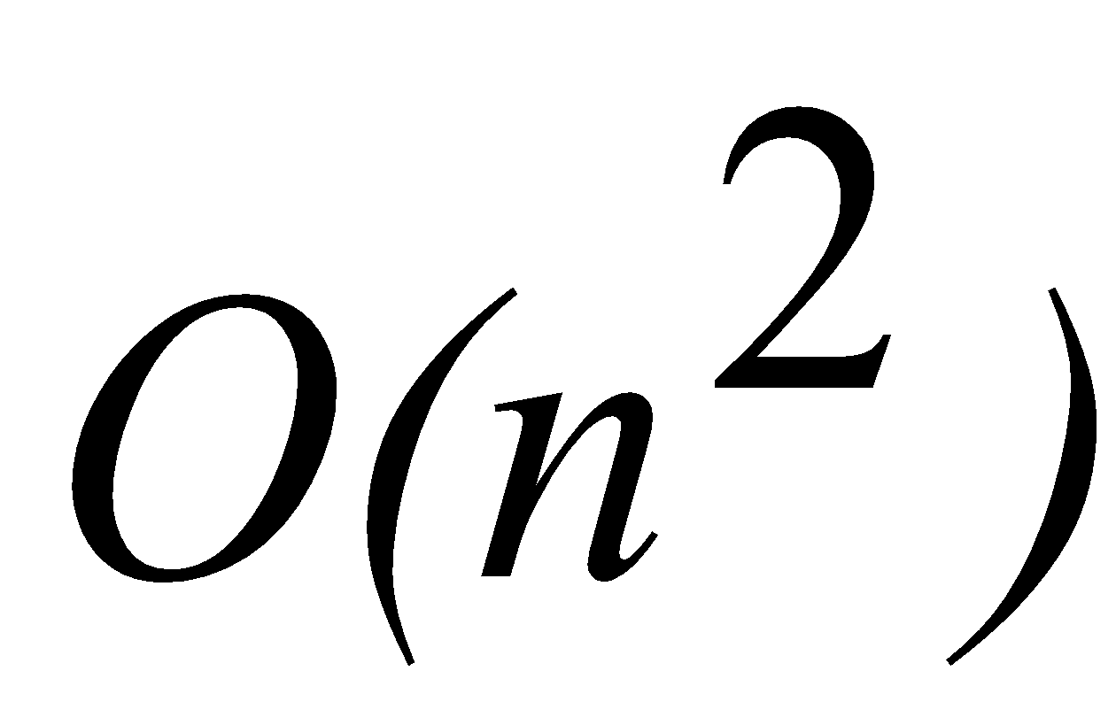
Data Organizing Principles - #5 Analysis
Correctness.
Flexibility.
When possible, compare different implementations of the same ADT.
Time Analysis
number of operations
big-O notation, e.g.,

Slide 26
Agendas
What is Data Structure?
Basic “Primitive” Data Types
Abstract Data Types “ADTs”
Data Structure & Data Types
Data Organizing Principles
Five Steps per Data Structure
Data Structure Examples

Slide 27
Data Structure Examples
Arrays This structure used to store elements in a linear format.
When it comes to the forms of arrays, we have to forms:
Singly Dimensional Array: store data in one dimension as a single row.
Multi Dimensional Array: store data in different dimensions, mostly in rows and columns.
Practical Example: Storing a contacts list in phones.

Slide 28
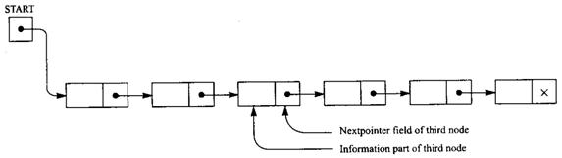
Data Structure Examples
Linked List & Doubly Linked List
It’s a data structure consisting of a group of nodes which together represent a sequence. Under the simplest form, each node is composed of a data and a reference (in other words, a link) to the next node in the sequence; more complex variants add additional links.
Practical Example: Image viewer in windows.

Slide 29
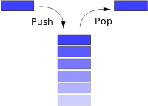
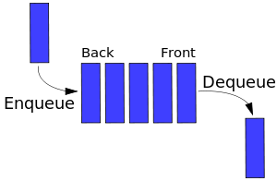
Data Structure Examples
Queues & Stacks
Queues used to store elements in a way that first stored element stored will be retrieved first, but Stacks retrieve last element first.
Practical Example
Queues: Adding orderes for printer.
Stacks: Implementing browser back function.
Queue
Stack

Slide 30
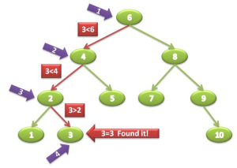
Data Structure Examples
Binary Tree
The pointers are lined up so that the structure forms the upside down tree, with a single node at the top, called the root node, and branches increasing on the left and right as you go down the tree.
Practical Example
Find all elements less than or greater than a certain value.

Slide 31
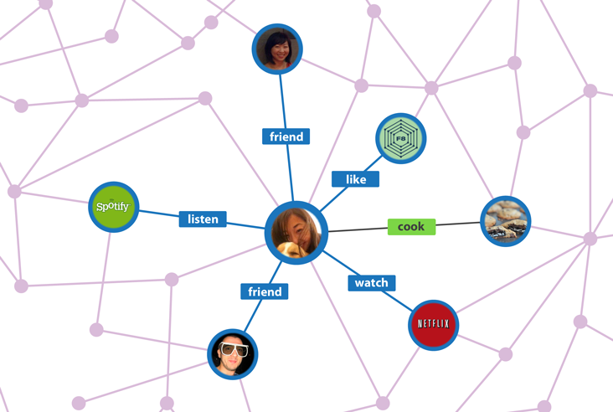
Data Structure Examples
Graph
A graph is a collection of nodes called vertices, and the connections between them, called edges.
Practical Example
Social networks friends and interactions.

